Slide 1
Welcome to Application Development Lab Course : CSE – 2216
Project By
Md. Waliur Rahman (01)
Shahzaman Mazumder (42)
Directed By:
Md. Rony Ahmed
Lecturer
Department of CSE
Faridpur Engineering College

Slide 2
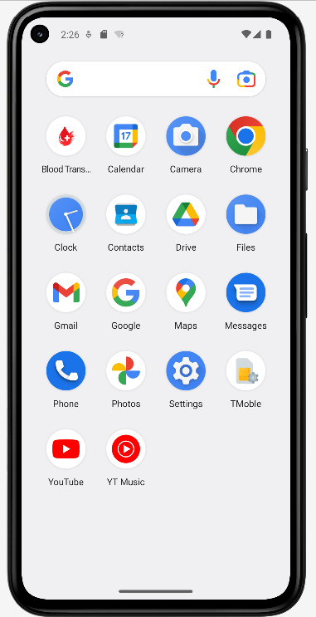
Blood Transfer
Application Name :

Slide 3
Goals
To easily search blood donors
Saving Life
Increasing awareness among people
Connect donors with patients
Introduction to Application Development

Slide 4


Development Platform
For development
For Storage and Authentication
Android Studio is the IDE that we used to create our app
We have used Firebase as a real-time database and G-mail authentication

Slide 5


Development Code
For Design
For programming
For design we used XML
As for programming language we used JAVA

Slide 6
Features
1.Searching Donor
2.Contacting Donor
3.Authentication
4.Easy to use
5.Real time data update
6.Requires very low storage

Slide 7
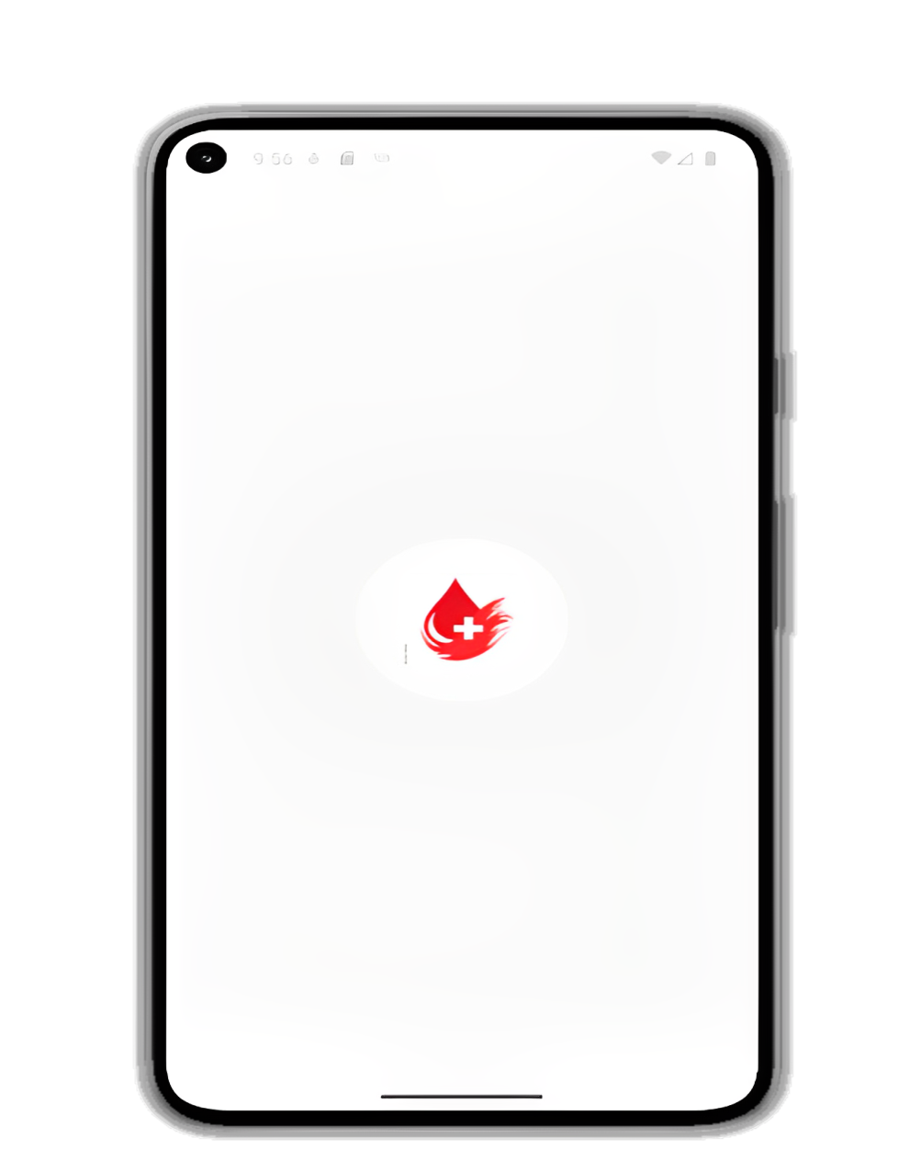
Application starts with a splash screen
Splash Screen

Slide 8
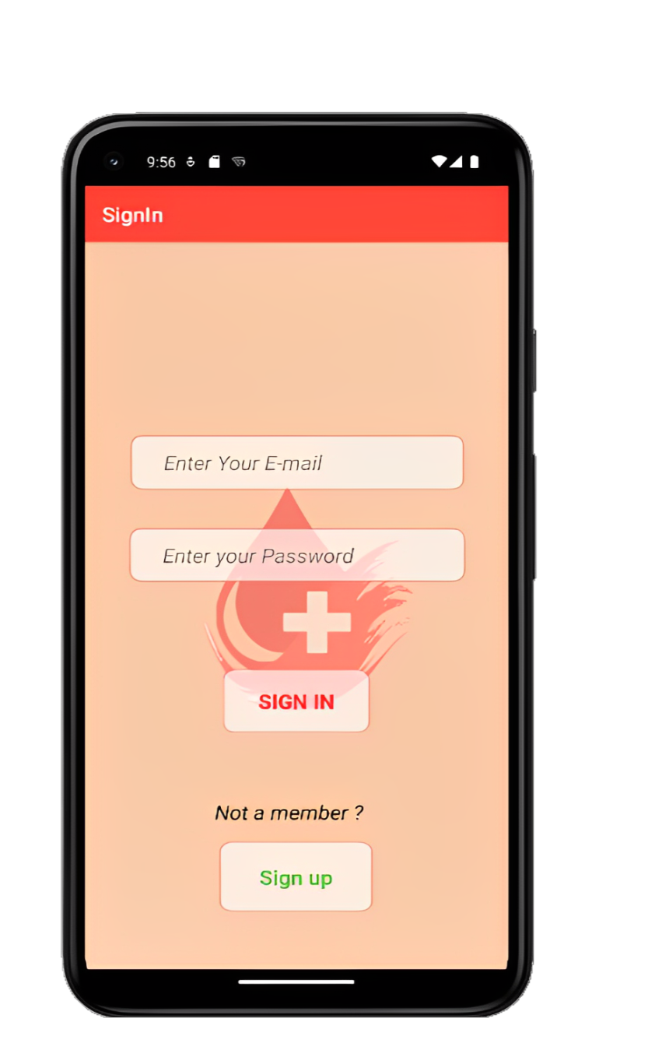
Already register people can Sign In using their E-mail and password or Go to Sign up page to become a new member
Sign In

Slide 9
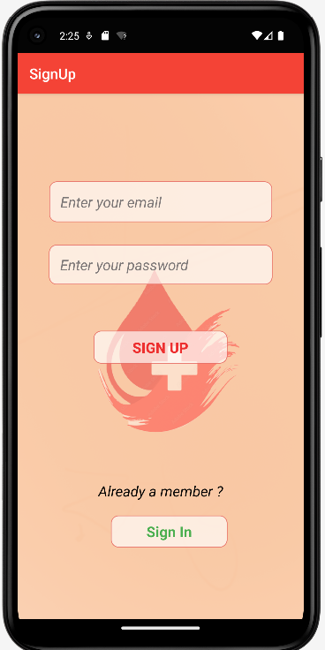
Not register people can Sign UP using their E-mail and password or Go to Sign in page if they are already a member
Sign Up

Slide 10
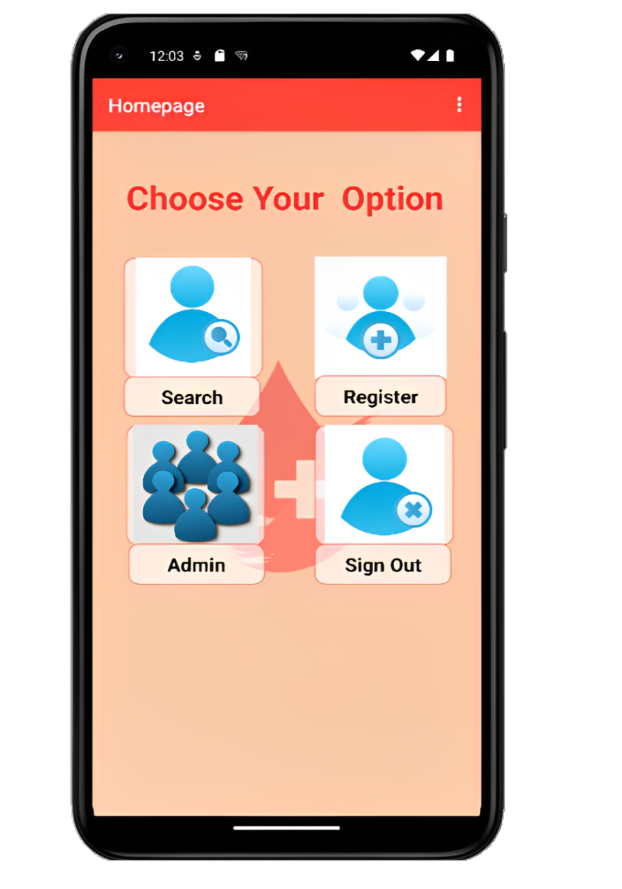
This is the main Home page from here user can go to 1.Search Page 2.Register Page 3.Admin Page 4.Signout Page
Home Page

Slide 11
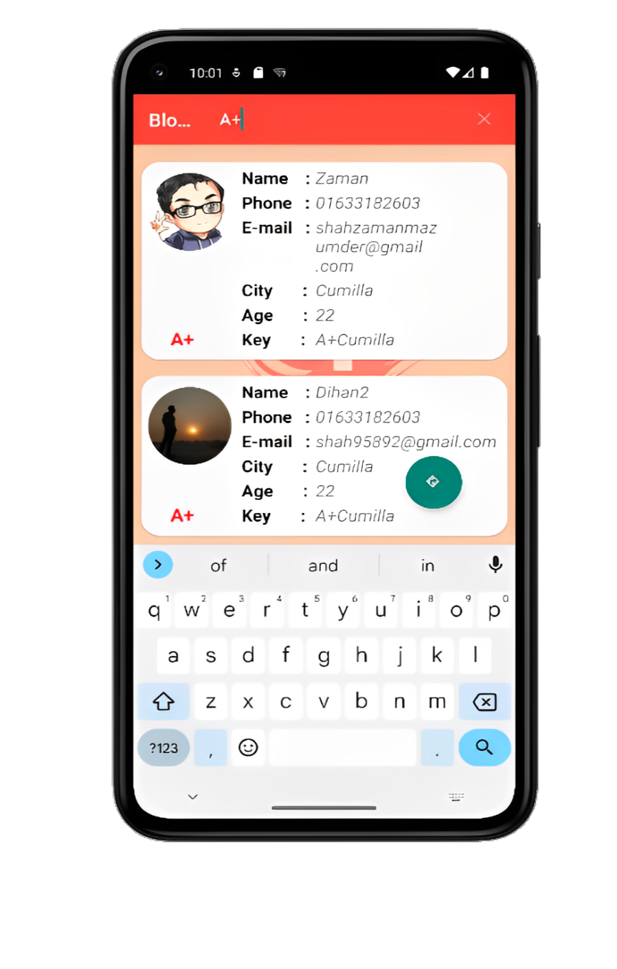
Users can see already registered people and search using Key . User can Call and Email by selecting
Search and List Page

Slide 12
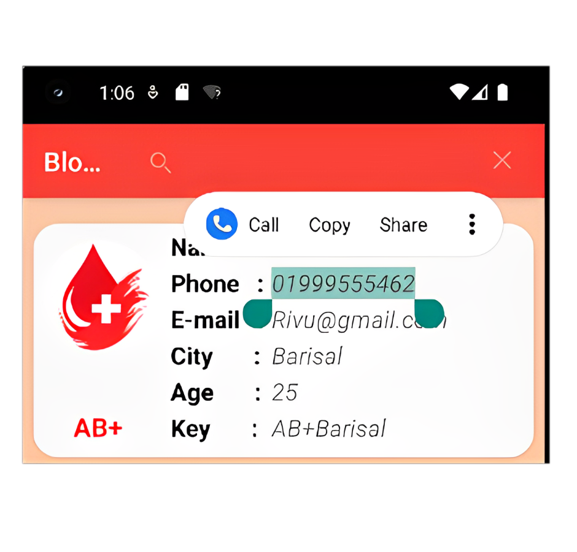
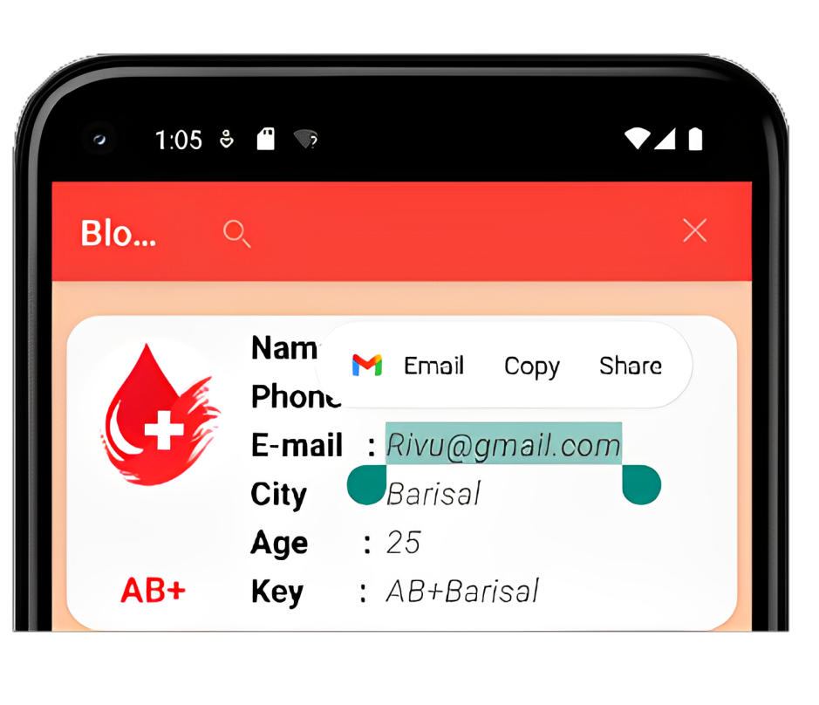
E-mail
Calling

Slide 13
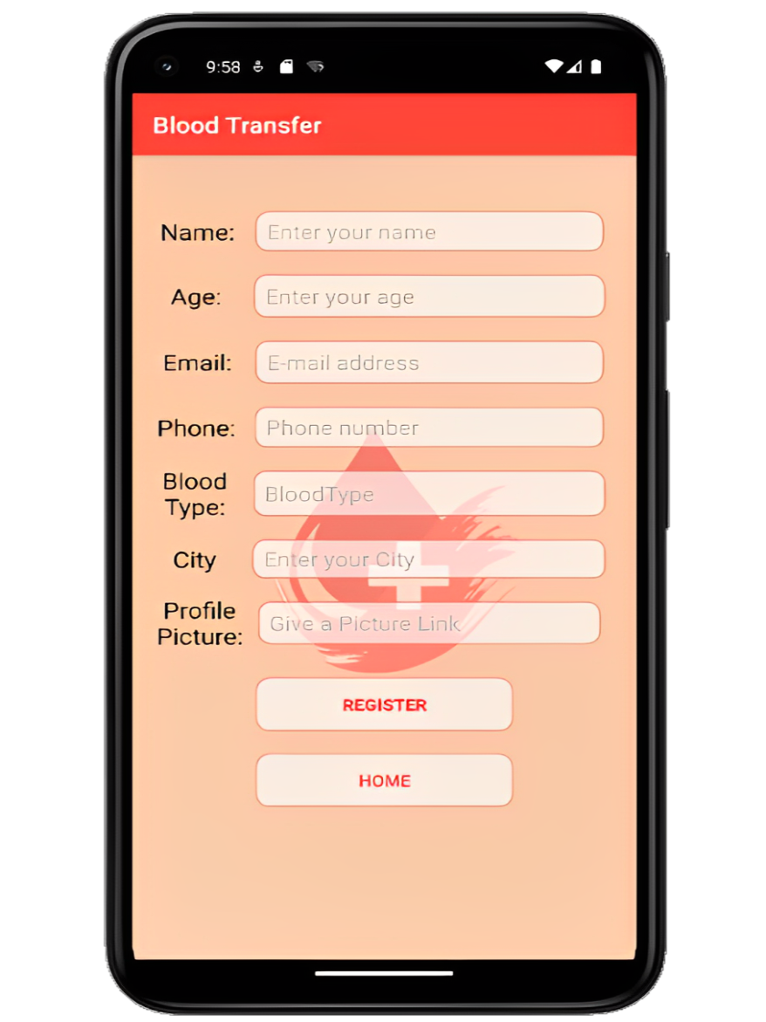
New Members can be added from here using name , age ,e-mail, phone, blood type , city and profile address
Registration Page

Slide 14
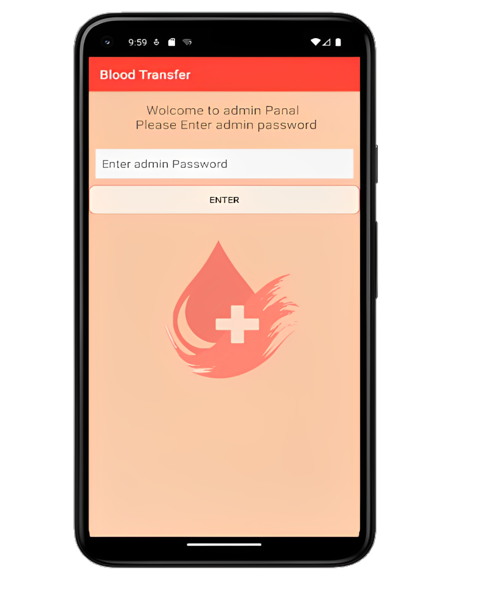
Admin Password is needed to access Admin Panel
Admin Authentication

Slide 15
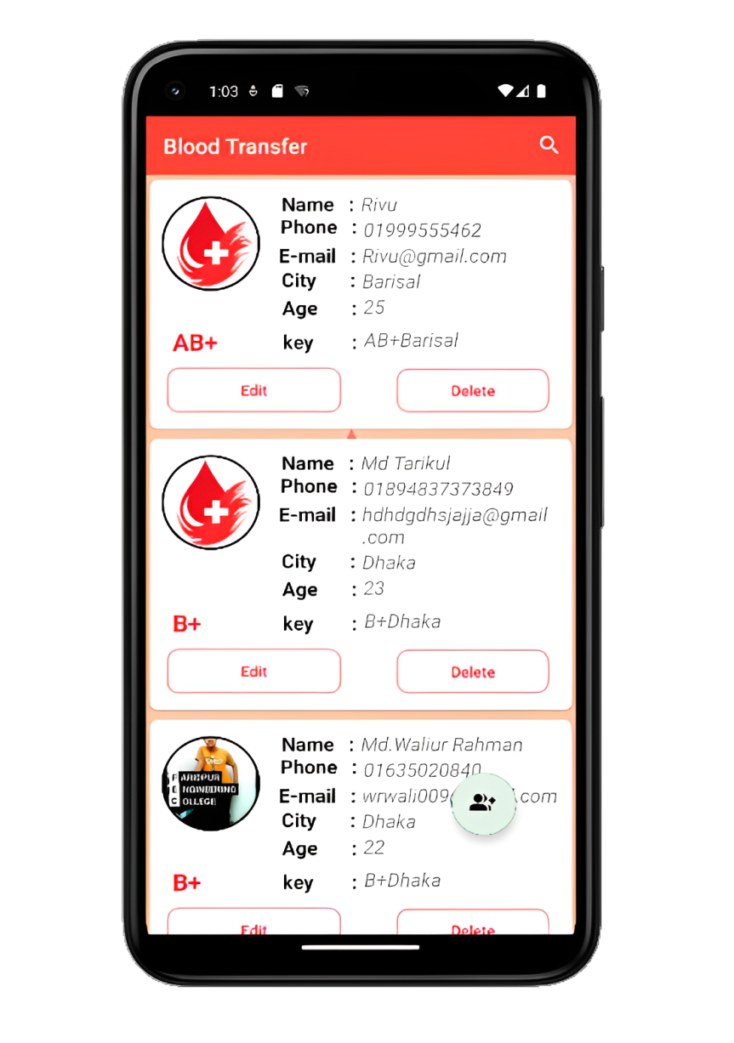
#Add #See List #Search #Call #E-mail # Edit and Delete data (if needed)
Admin Panel
Admin have few more option than a normal user admin can

Slide 16
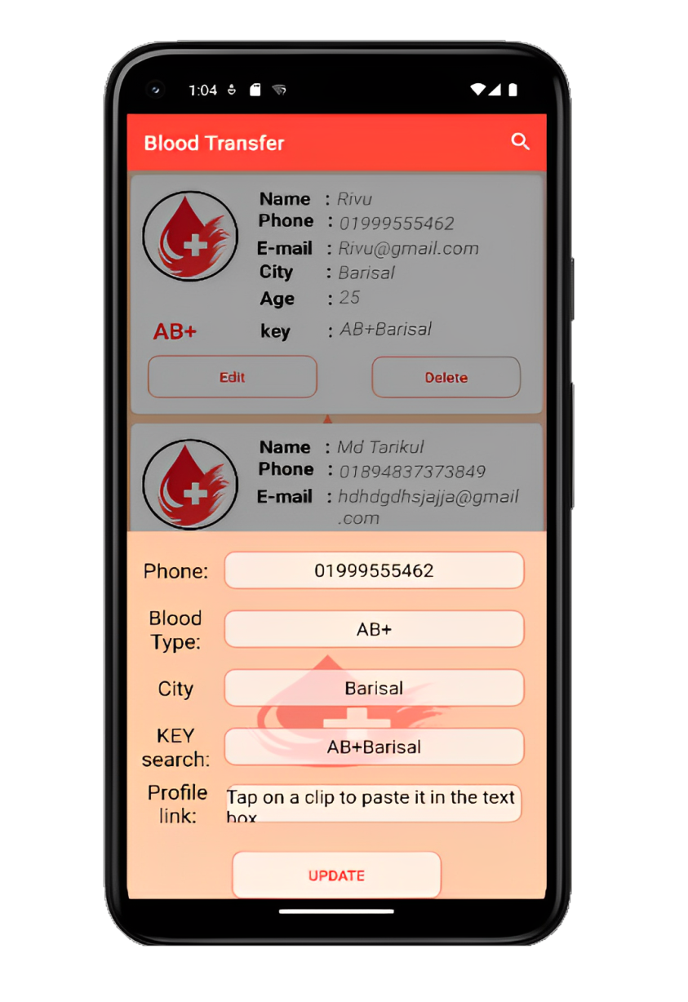
Delete
Update

Slide 17
Sign out
User can sign out using this option and go back to Sign In page

Slide 18
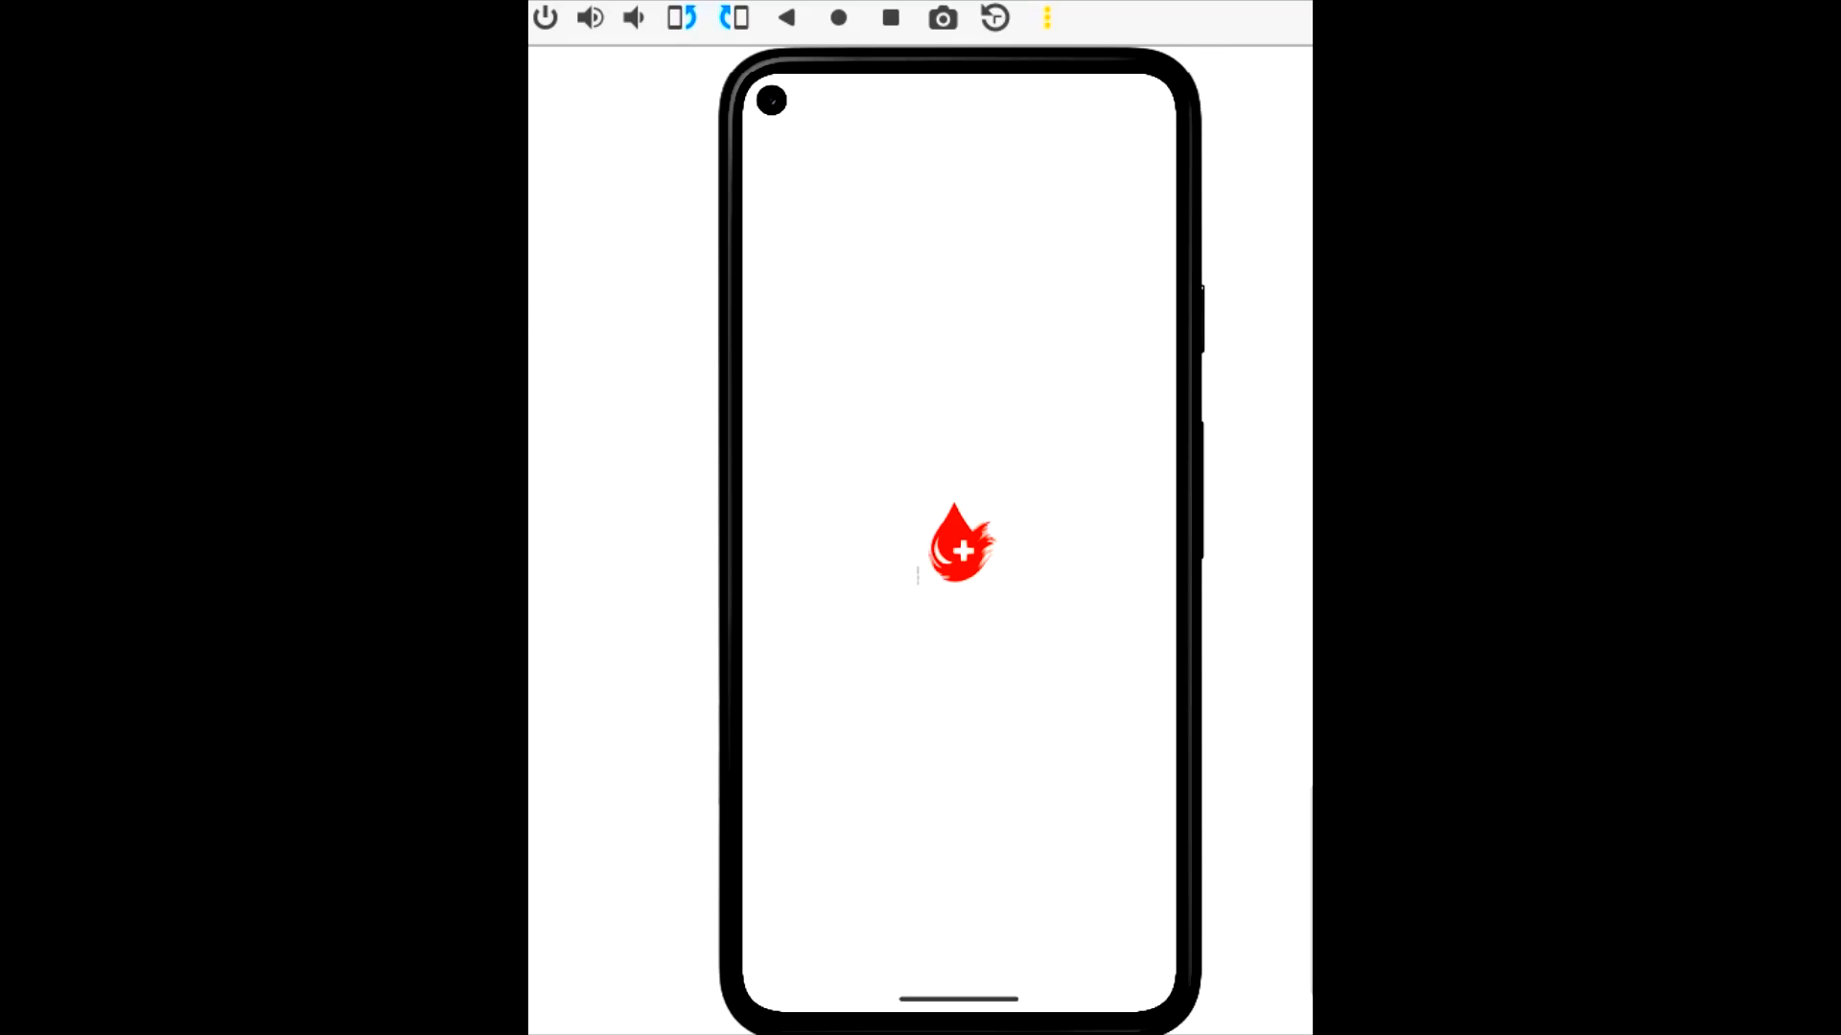
Project Video
Here is a short overview of our project

Slide 19
Thank You

